Slide 1
LM-470 REMOVAL
& INSTALLATION
The LM-470 is a 72 foot tower that weighs about 1100 pounds. To move the tower requires a long trailer and a ¾ ton truck with towing capabilities. The tower was in Valley Springs and was moved to Wilton, CA. Then comes the fun.

Slide 2
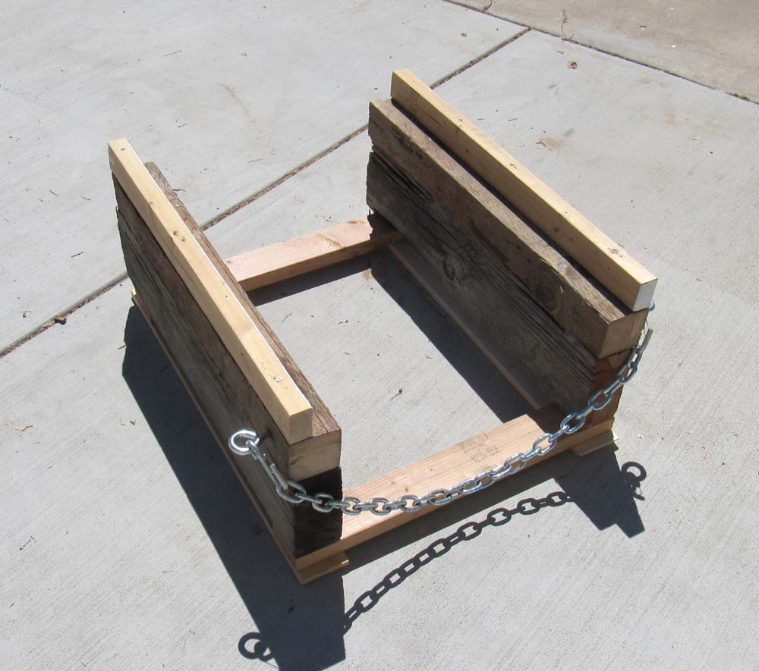
The sled is designed to hold the bottom of the tower and allow clearance for the drum and cables. Eye bolts allow the sled to be dragged into position.

Slide 3
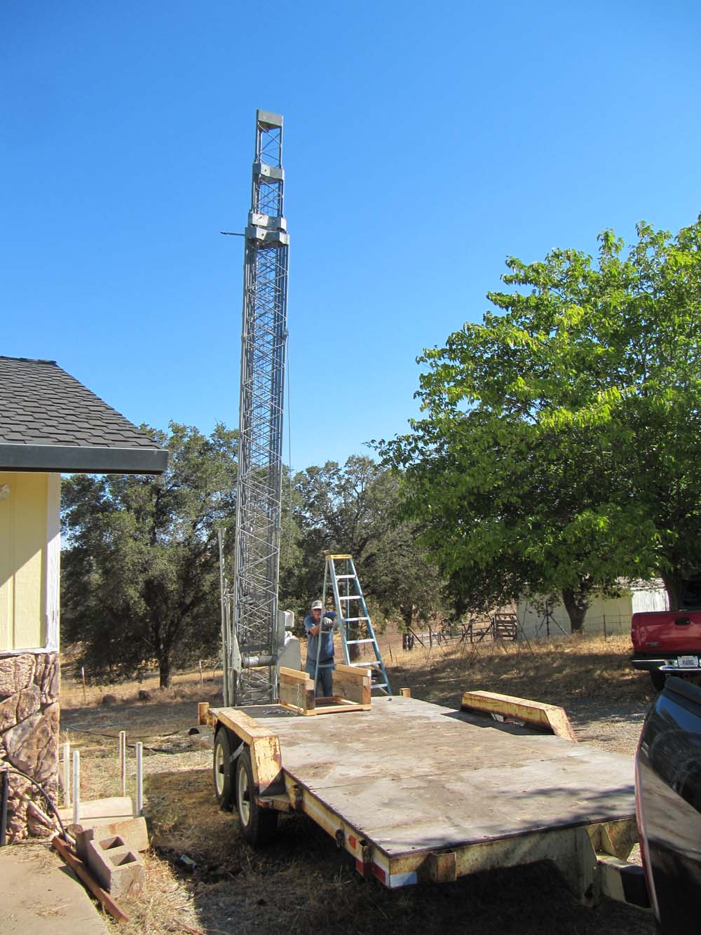
Tilt trailer is driven into position at the base of the tower. Trailer is 20 feet long.

Slide 4
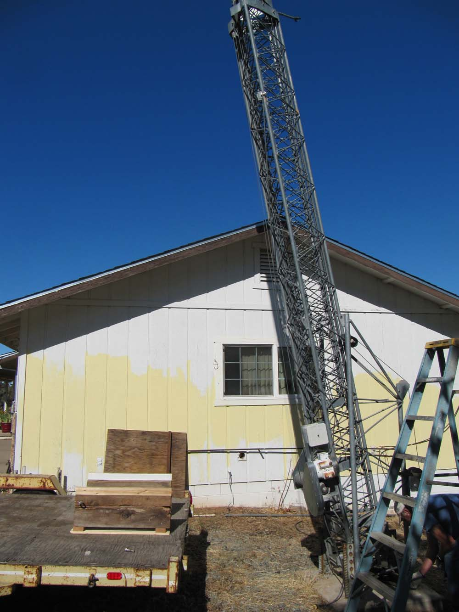
A 4 inch pulley is installed 7 and a half feet up the tower. Starting down.

Slide 5
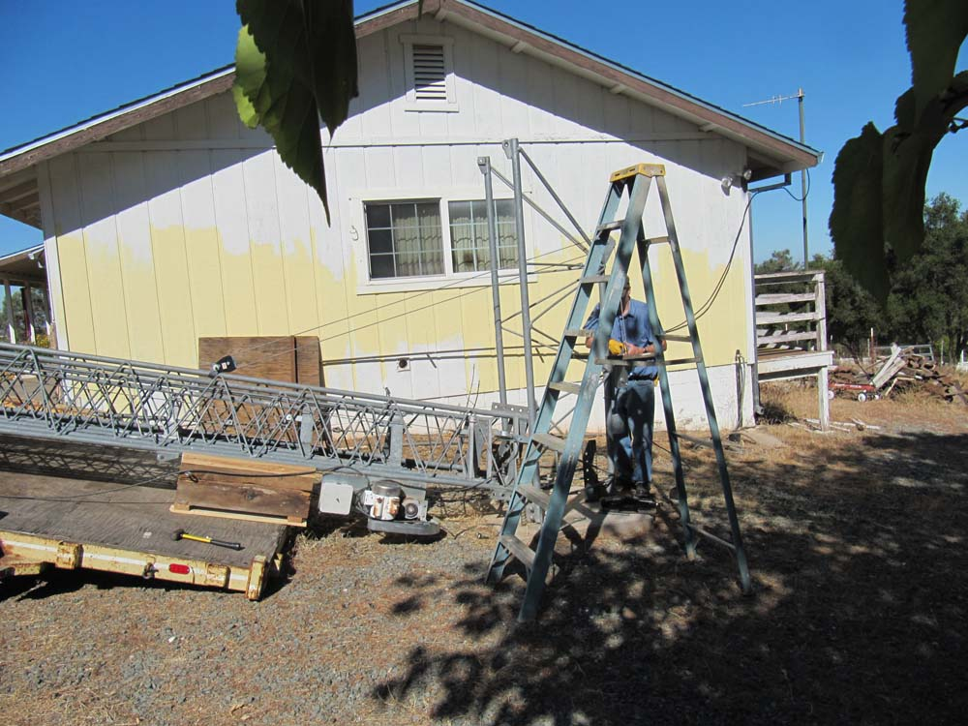
The trailer tilts when the weight of the tower is applied.

Slide 6
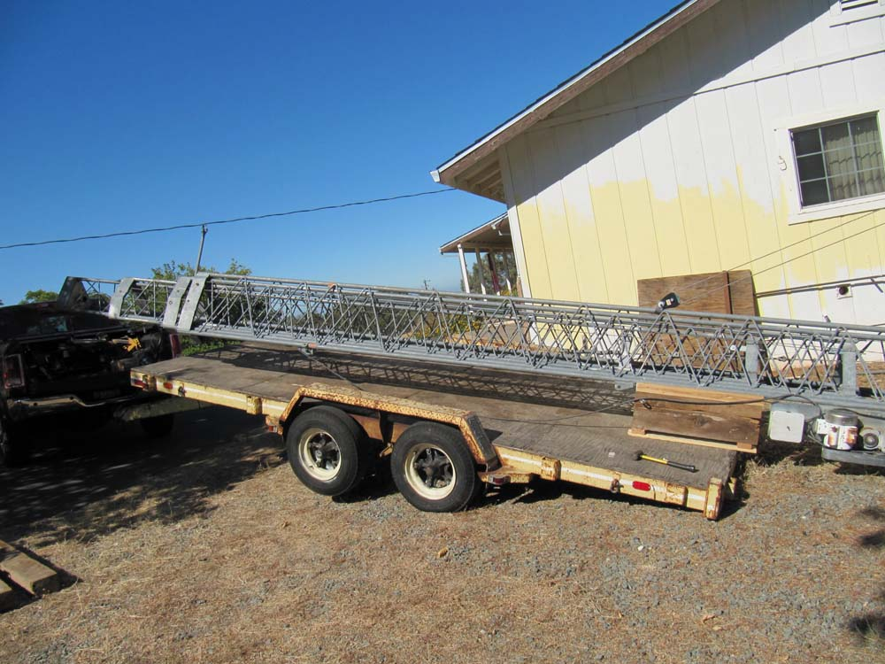
The antenna is fully down and parallel with the bed.

Slide 7
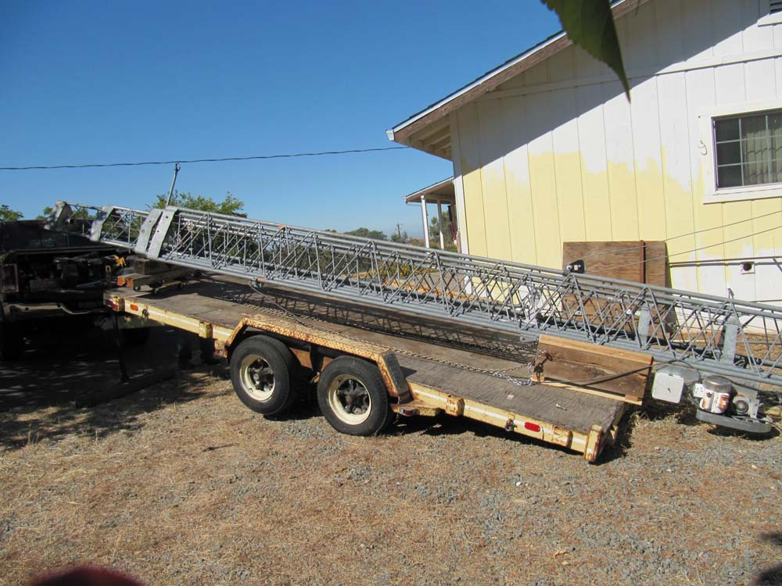
A dolly and some 4X6s support the top of the tower.

Slide 8
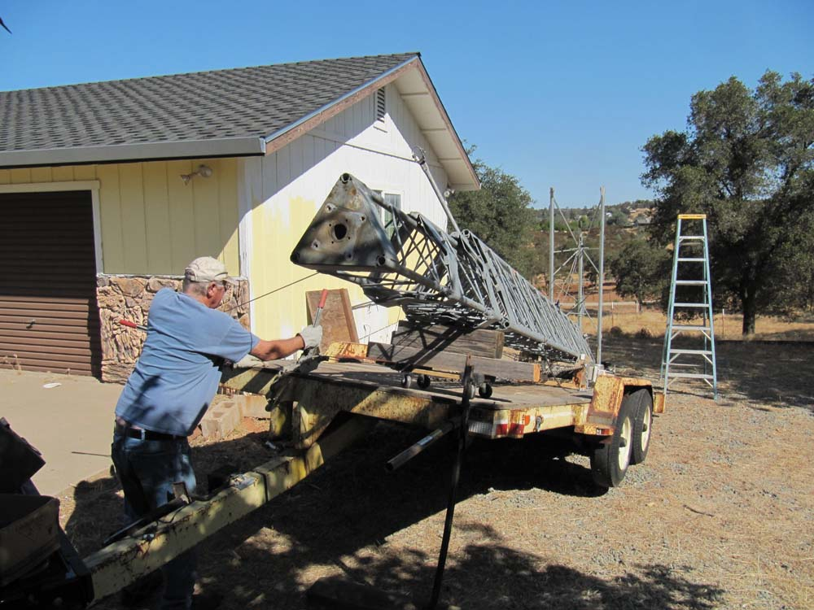
A pair of come alongs are used to center the tower and pull the sled into position.

Slide 9
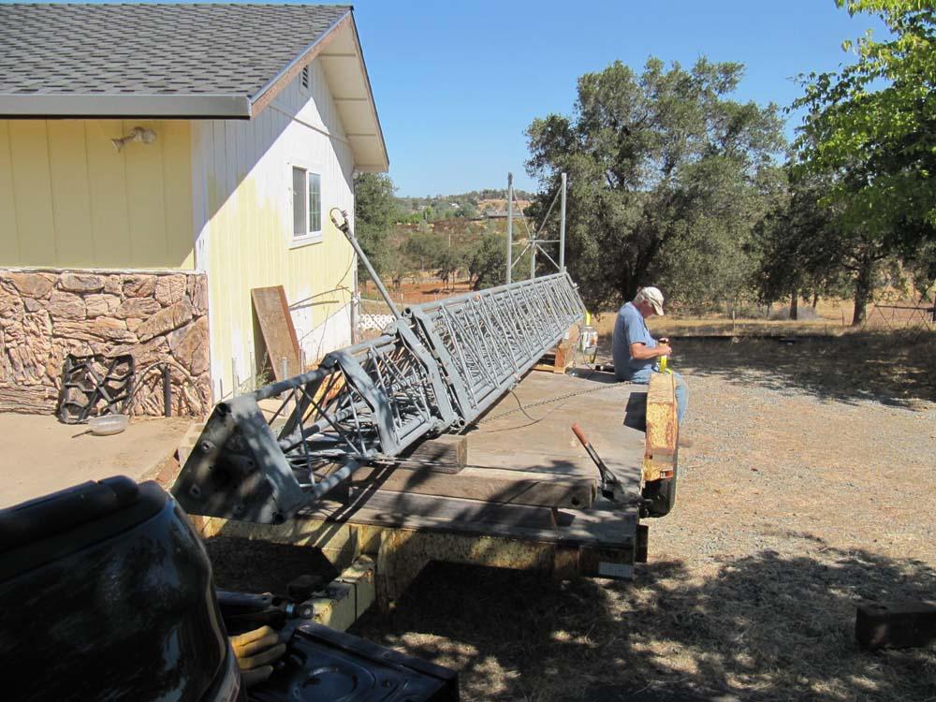
Dolly removed.

Slide 10
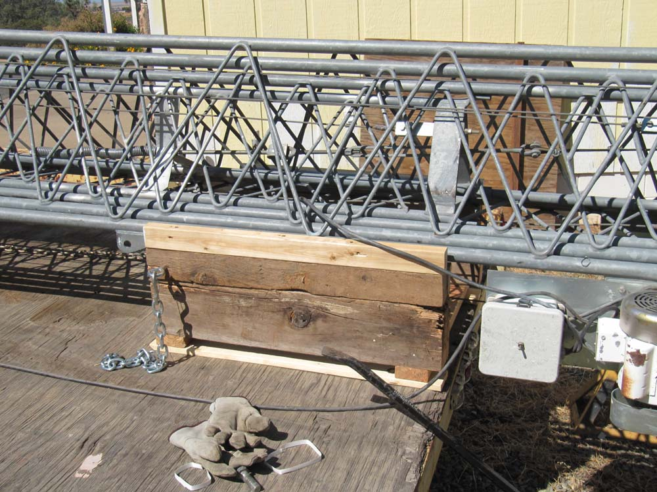
Sled is in position and ready for final tie down. Time on site was 2 hours.

Slide 11
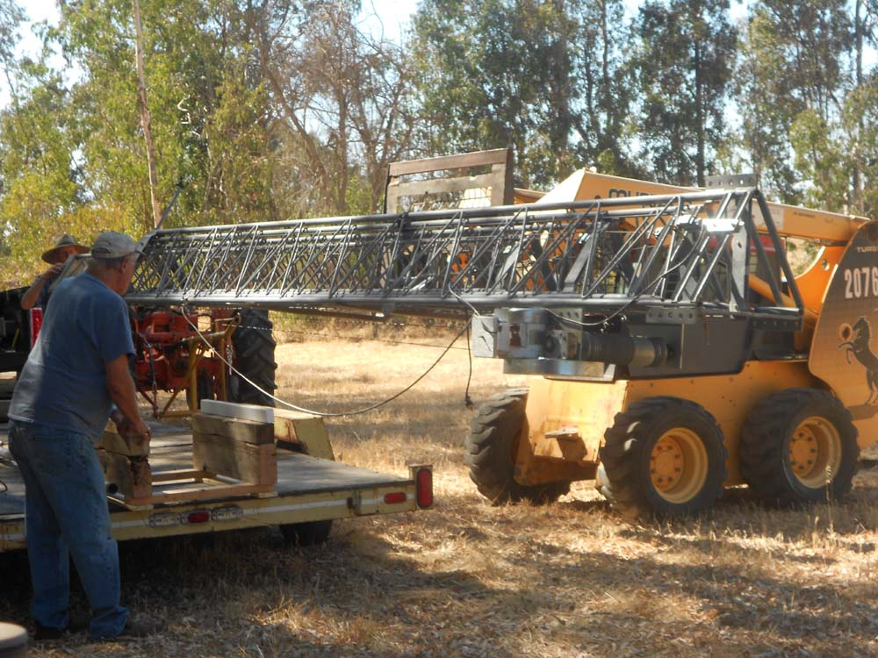
Once in the back pasture in Wilton, the Bob Cat fork lift easily handled the load.

Slide 12
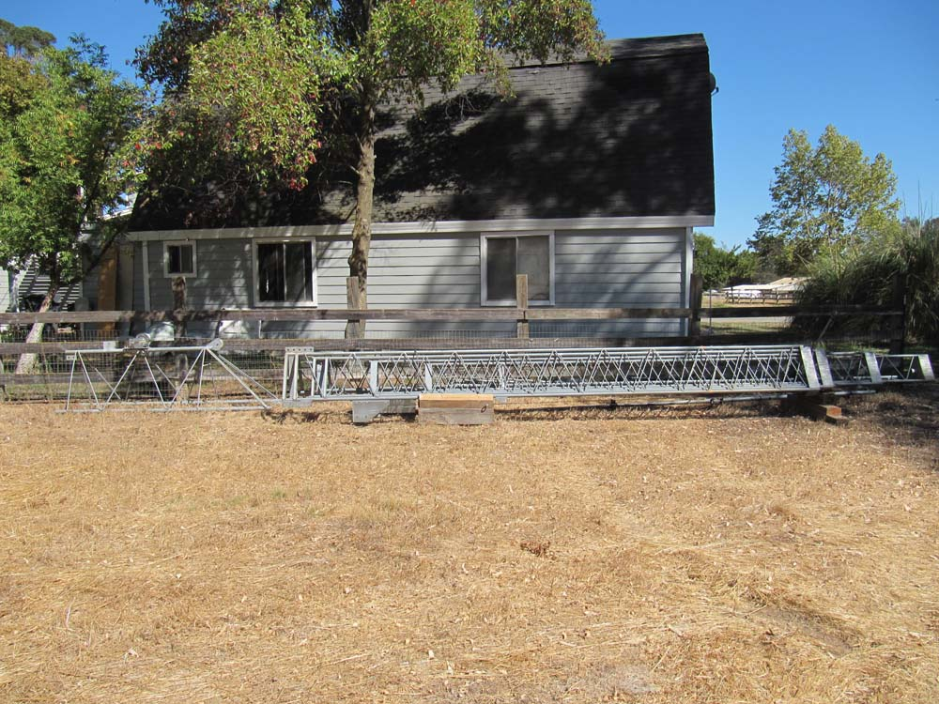
The sled and other lumber were used to safely support the tower until the base is ready.

Slide 13
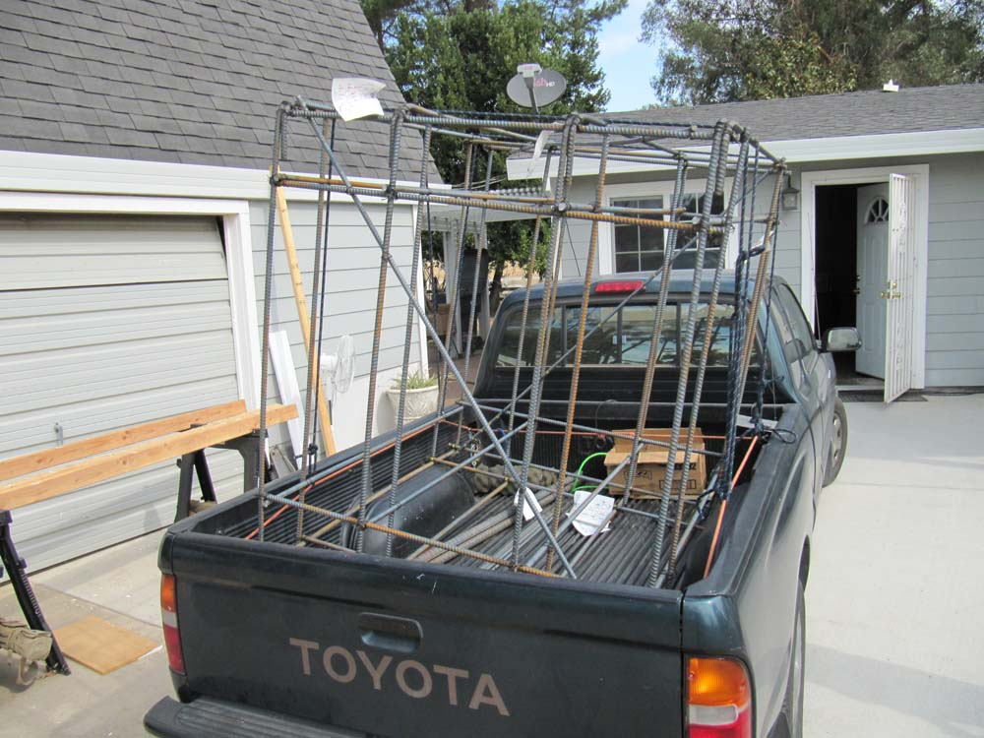
The rebar cage arrives. We rolled the cage off the tailgate.

Slide 14
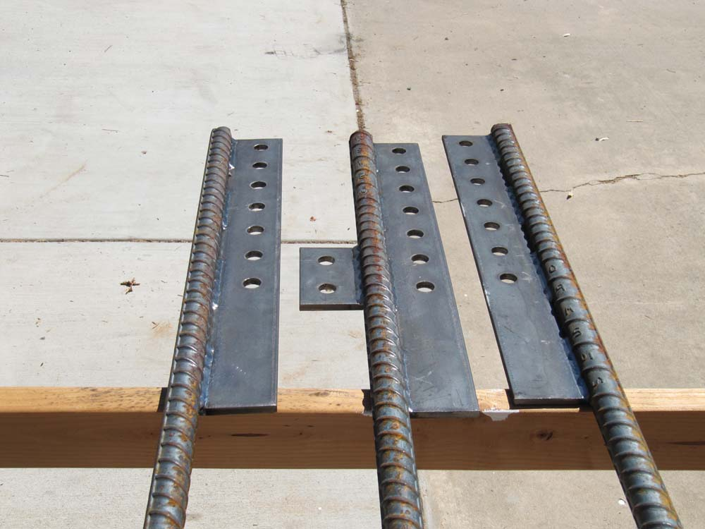
#10 rebar is welded to the mounting ears. The tops of the rebar were ground flat so the frame could be leveled.

Slide 15
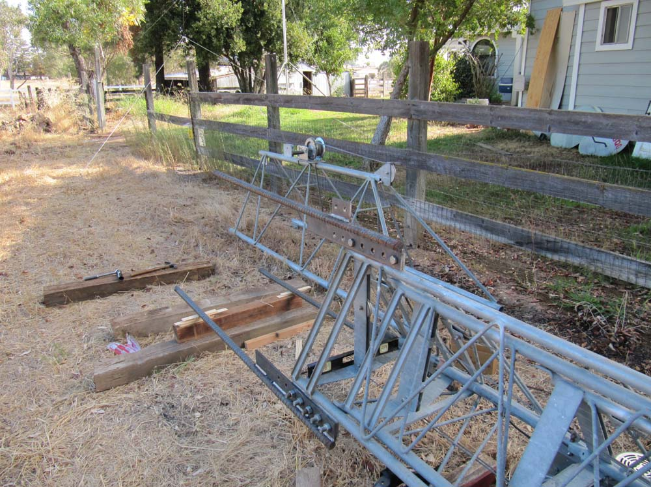
The ears are attached to the base of the tower.

Slide 16
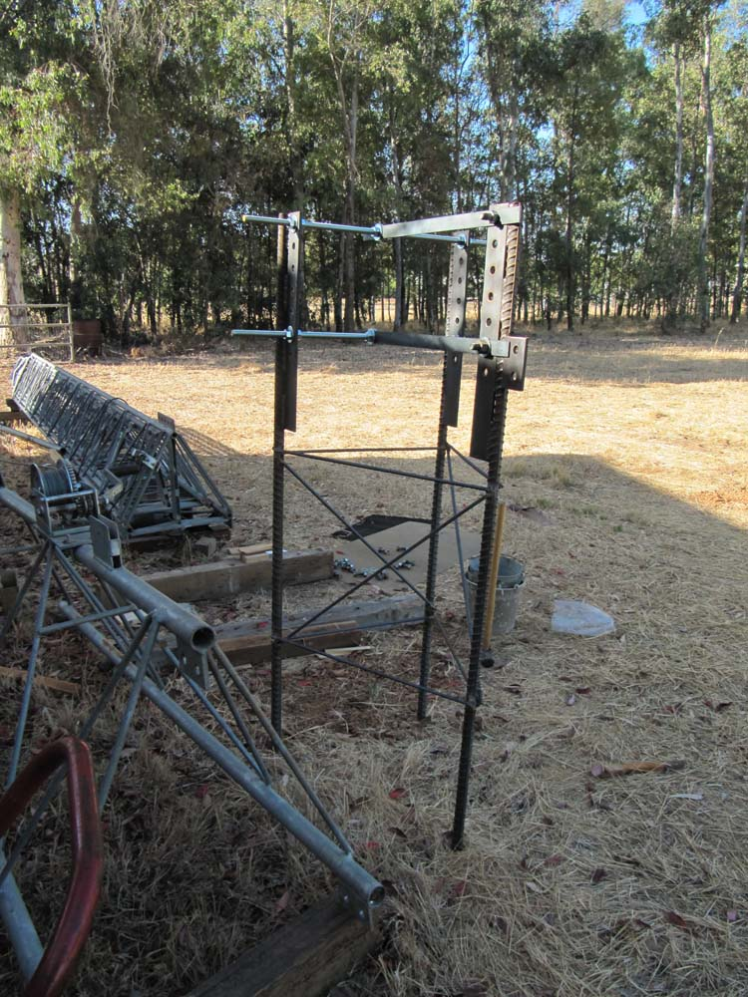
Support rebar is welded to the #10 bars before it is removed. The all-thread and steel braces hold the position of the rebar. This was a necessity as the base frame was bounced around but never lost its shape or alignment.

Slide 17
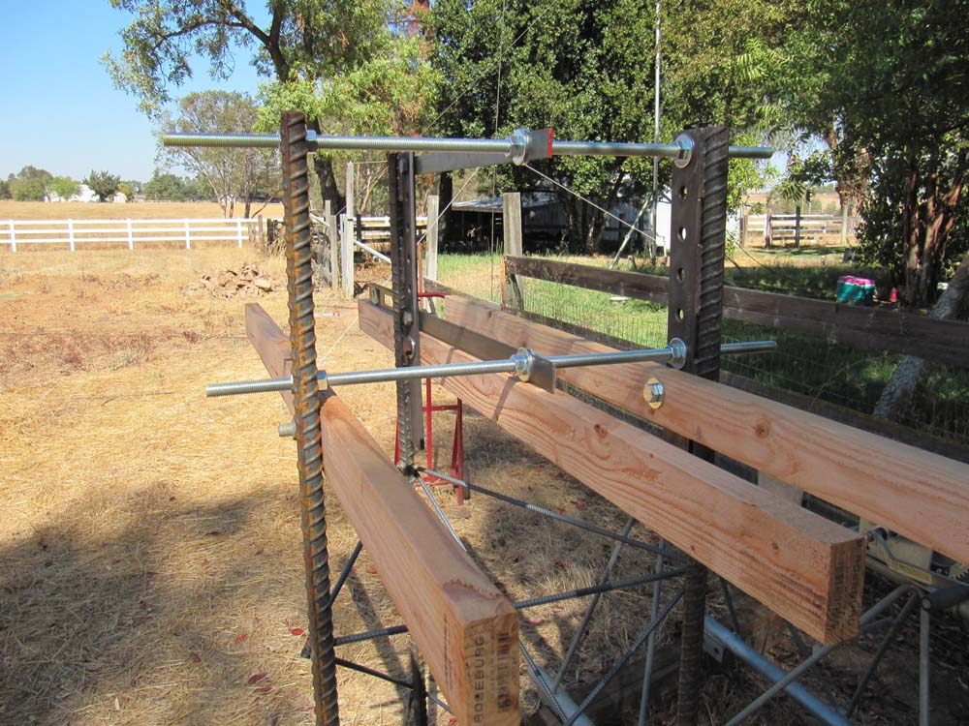
The support 2X4 lumber is added. One stud for each rod with a hole to give ½ inch space above the cement level so the cement would flow between the sides.

Slide 18
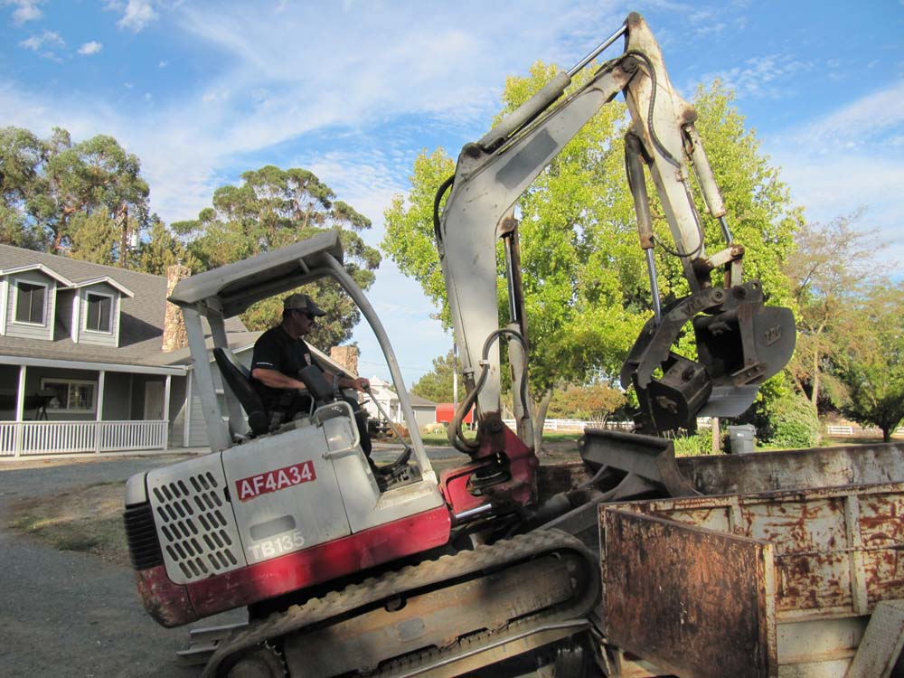
Excavator arrives

Slide 19
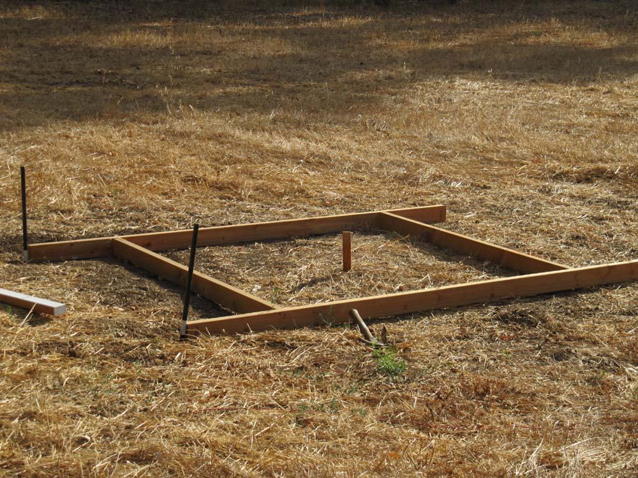
Target

Slide 20
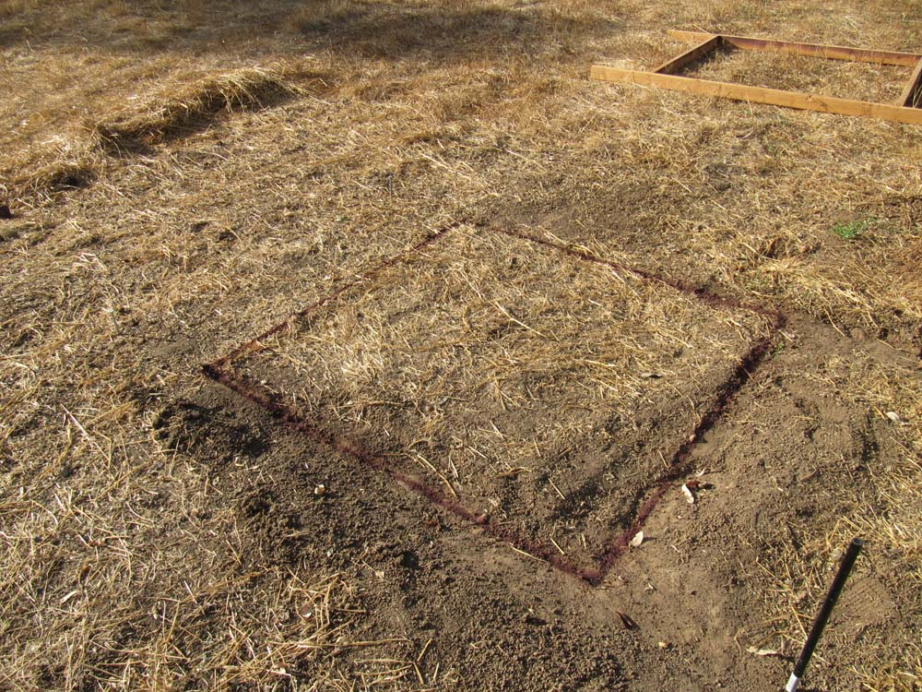
Painting the ground

Slide 21
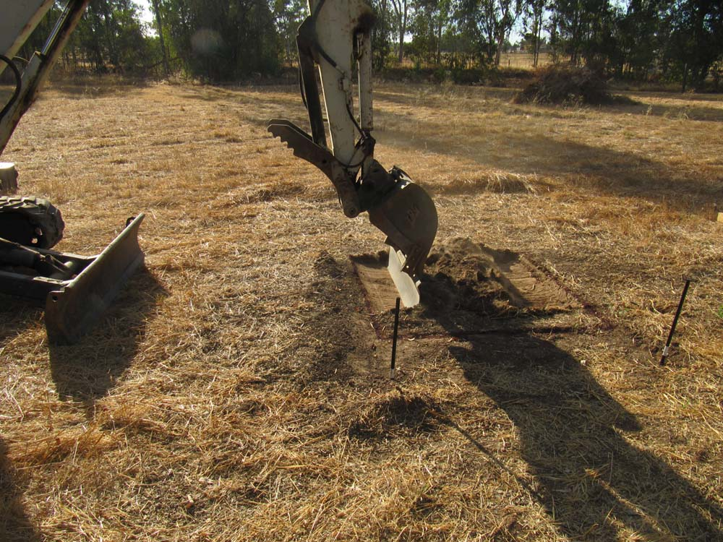
Precision scraping

Slide 22
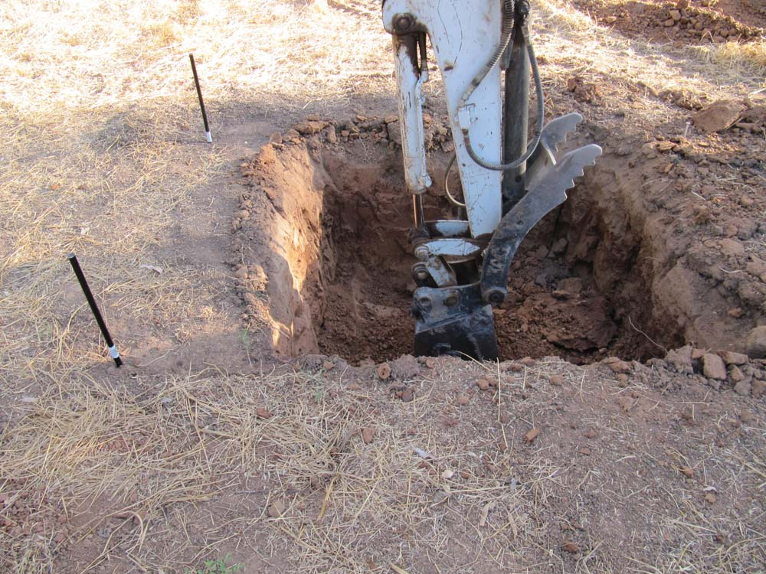
Hardpan

Slide 23
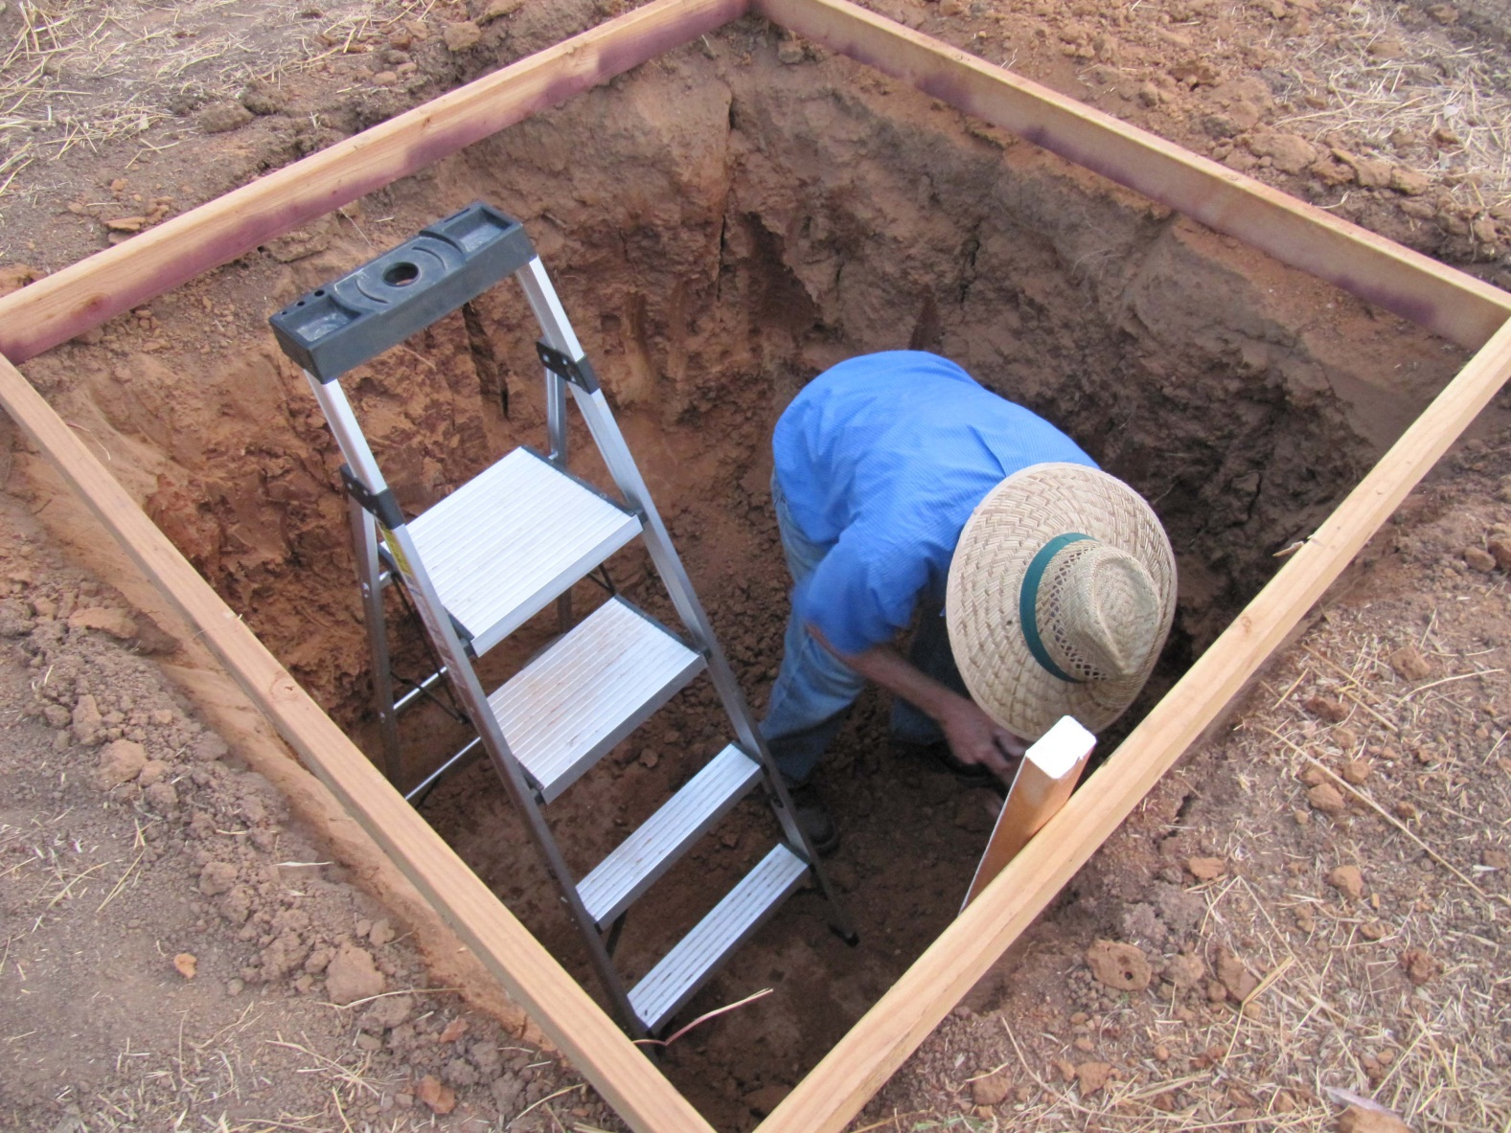
Squaring the hole

Slide 24
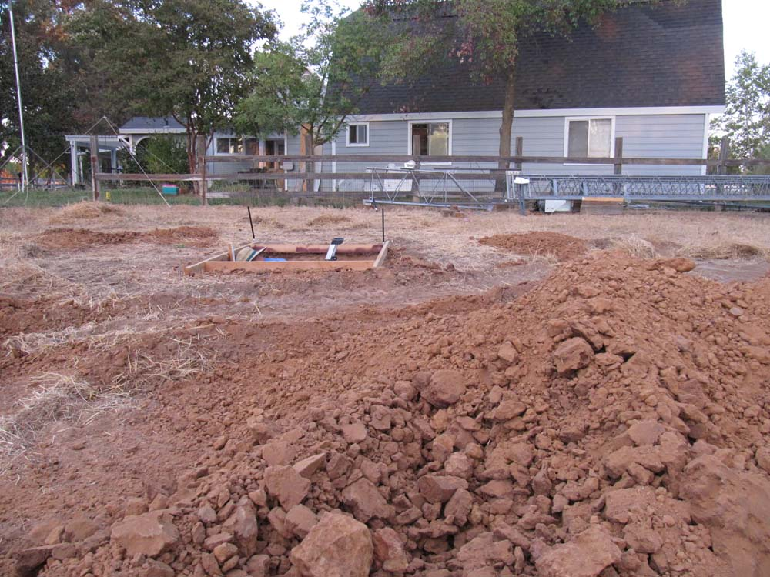
Gopher

Slide 25
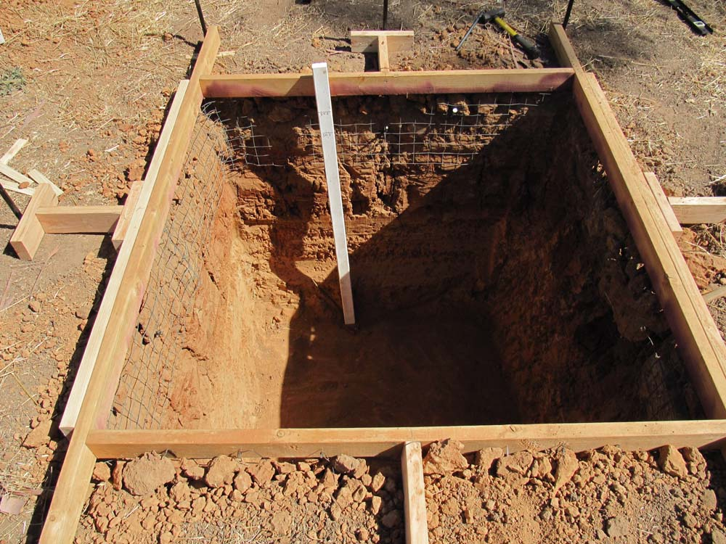
Hog wire was added to stabilize the sides. Measuring post was marked for depth of hole and the level of crushed rock.

Slide 26
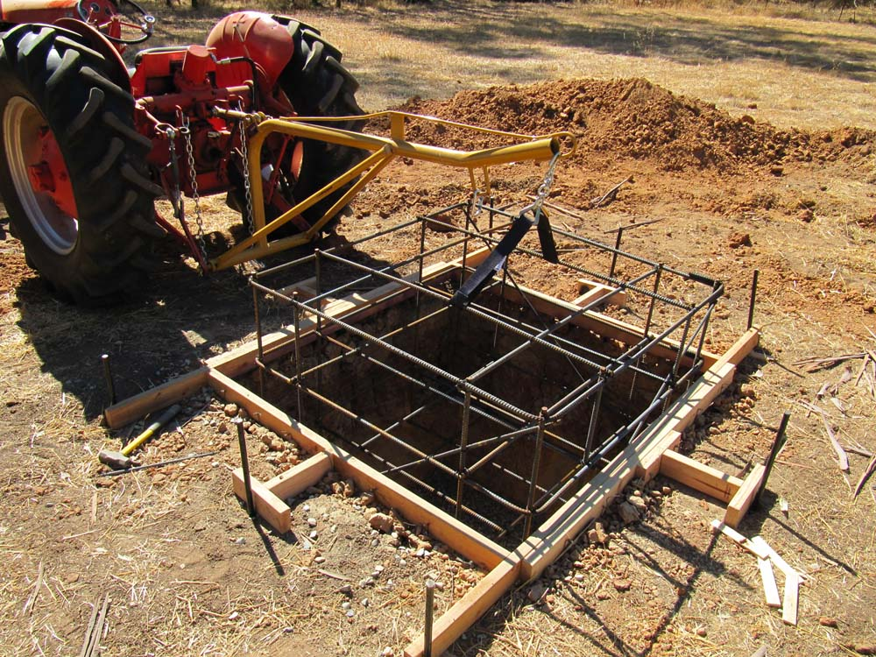
Dropping in the cage

Slide 27
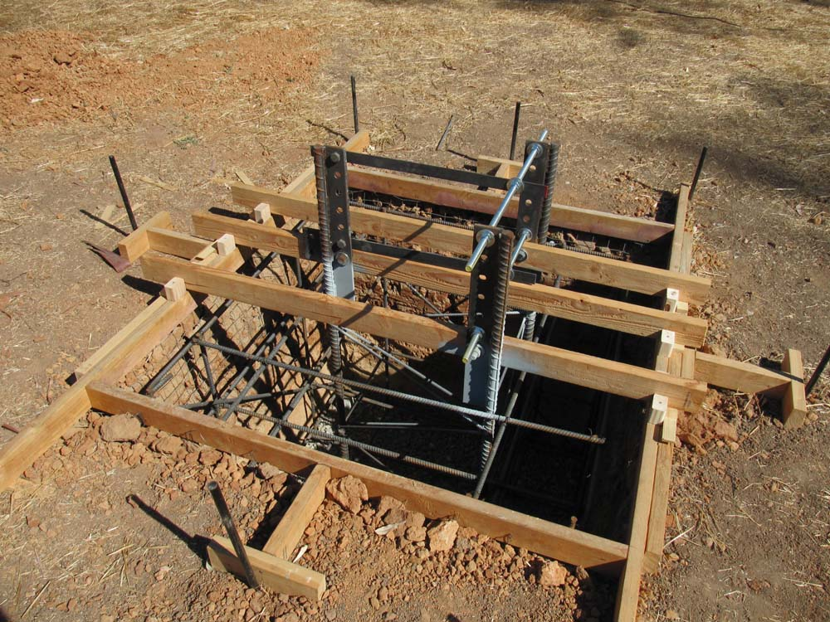
Ready for cement. Galvanizing painted to the rebar and ears. Foundation stakes hold the form level. The “T” braces are to hold the shape without making the sides unstable.

Slide 28
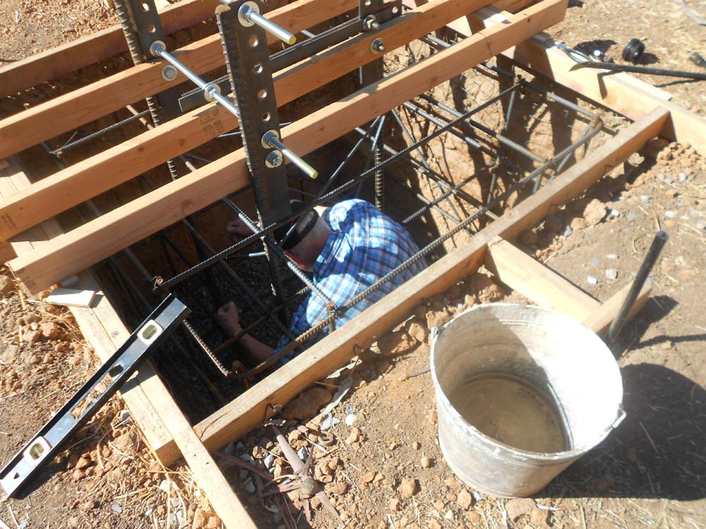
The footings and rebar needed adjustment. How did he get in and how did he get out?

Slide 29
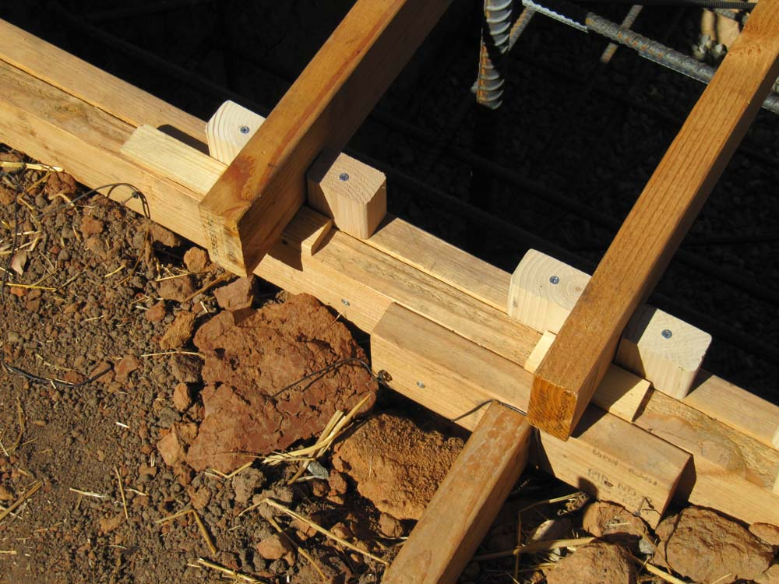
Adjusting blocks that are ½ inch thick are under each end of the studs to bring the frame to the correct level. Small blocks were installed to keep the frame from moving. Two door shims were needed to make the base frame level.

Slide 30
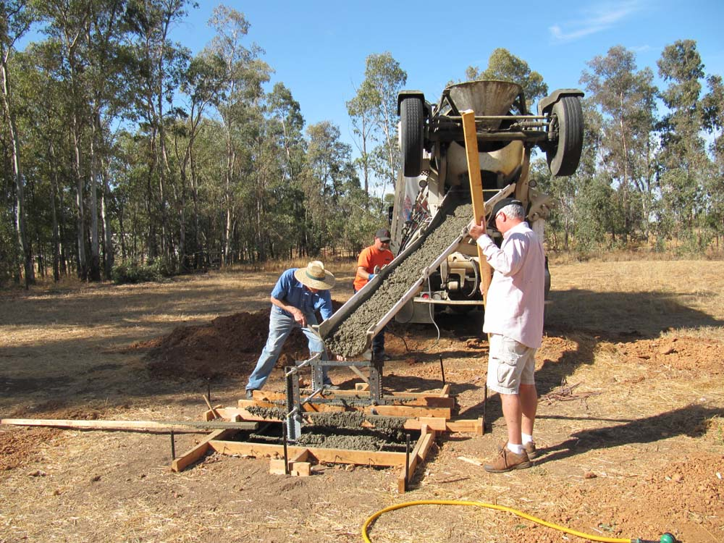
Cement truck arrives

Slide 31
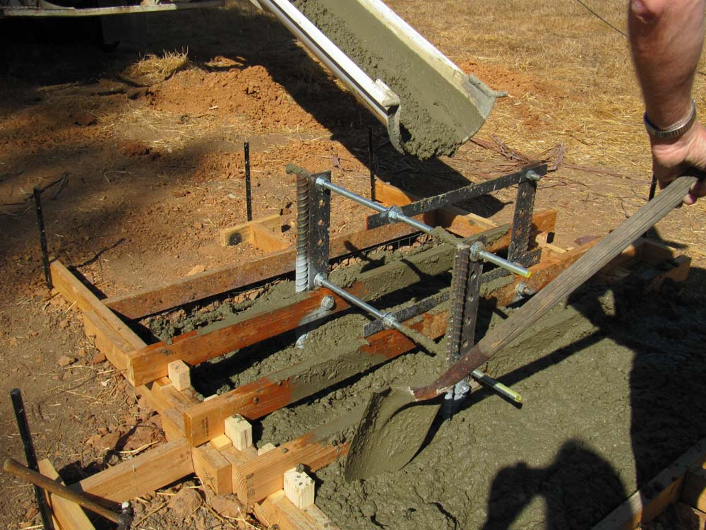
Trying to be neat

Slide 32
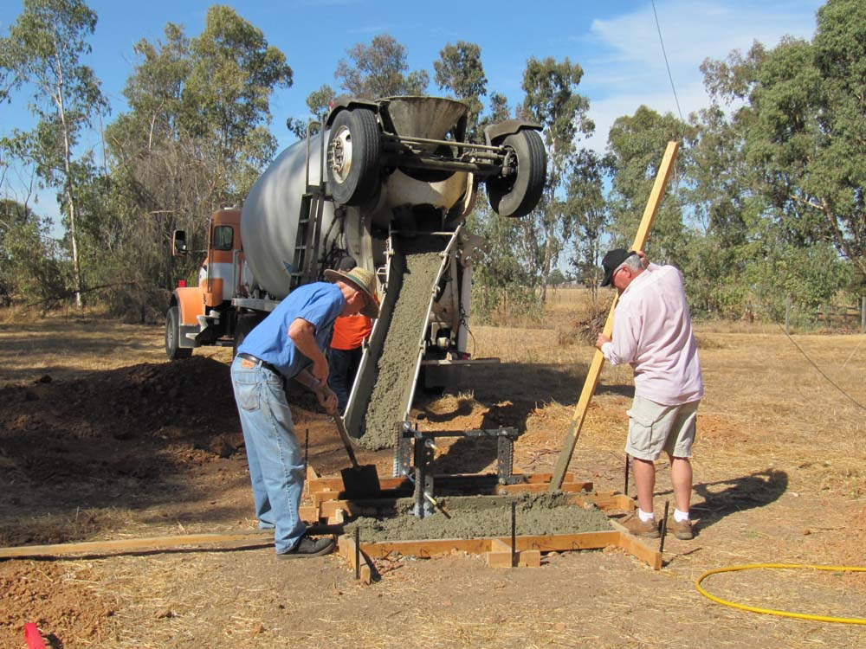
Filling in the holes.

Slide 33
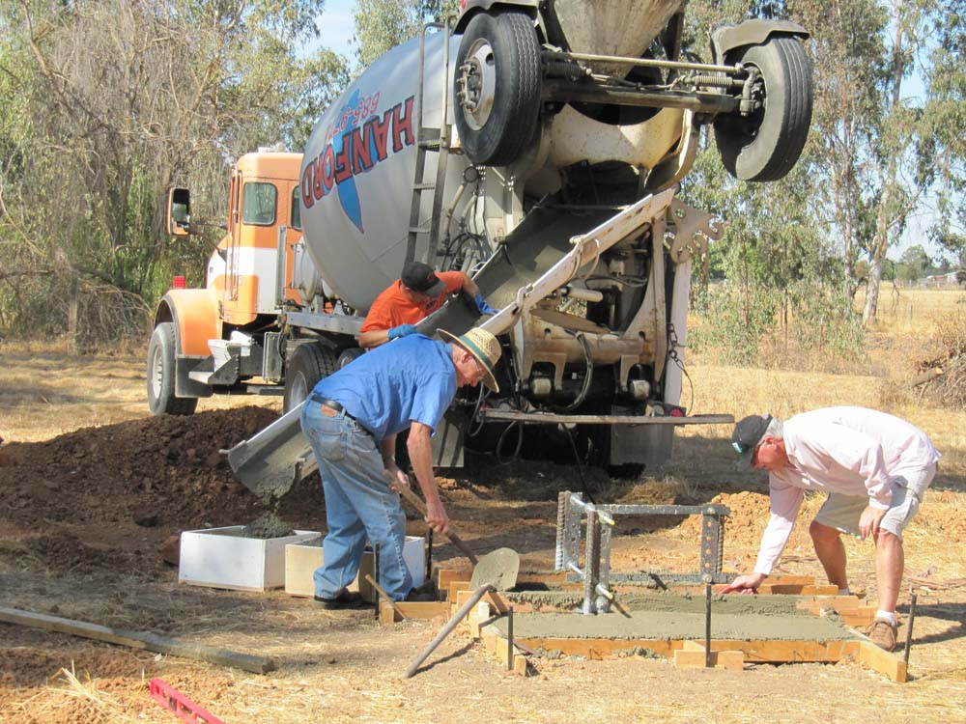
Starting the leveling and the filling of some counter weights.

Slide 34
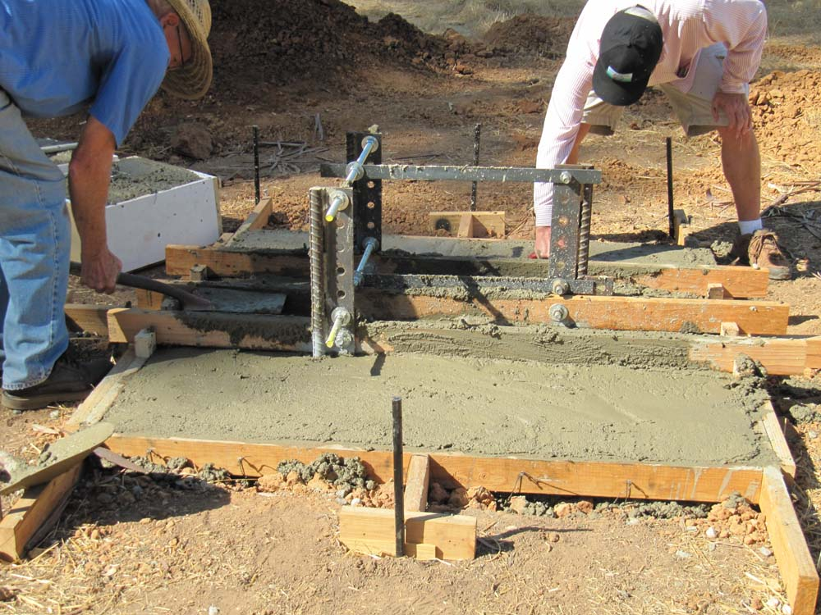
Cement workers

Slide 35
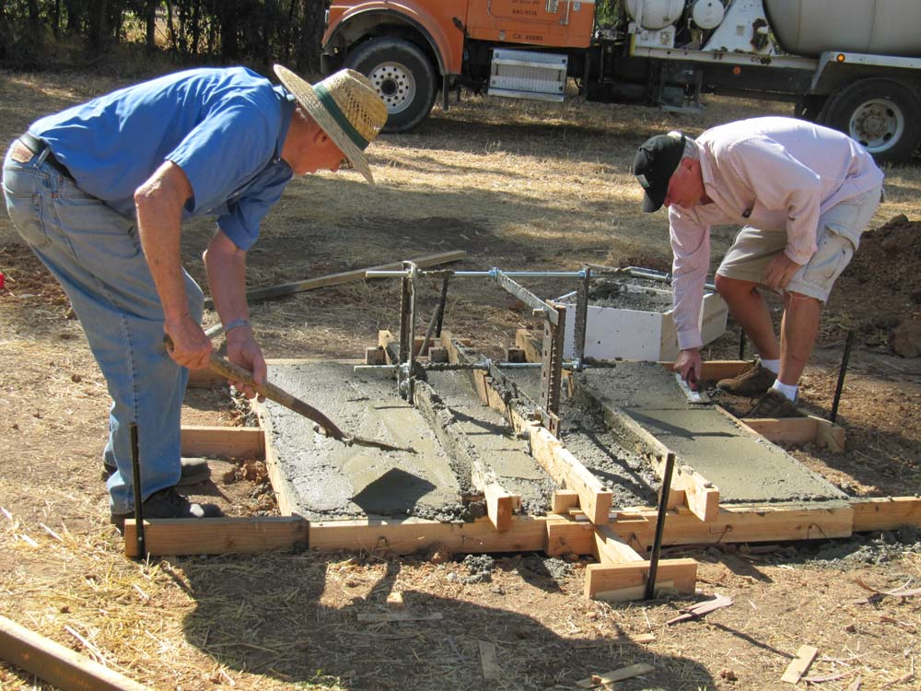
Getting it flat

Slide 36
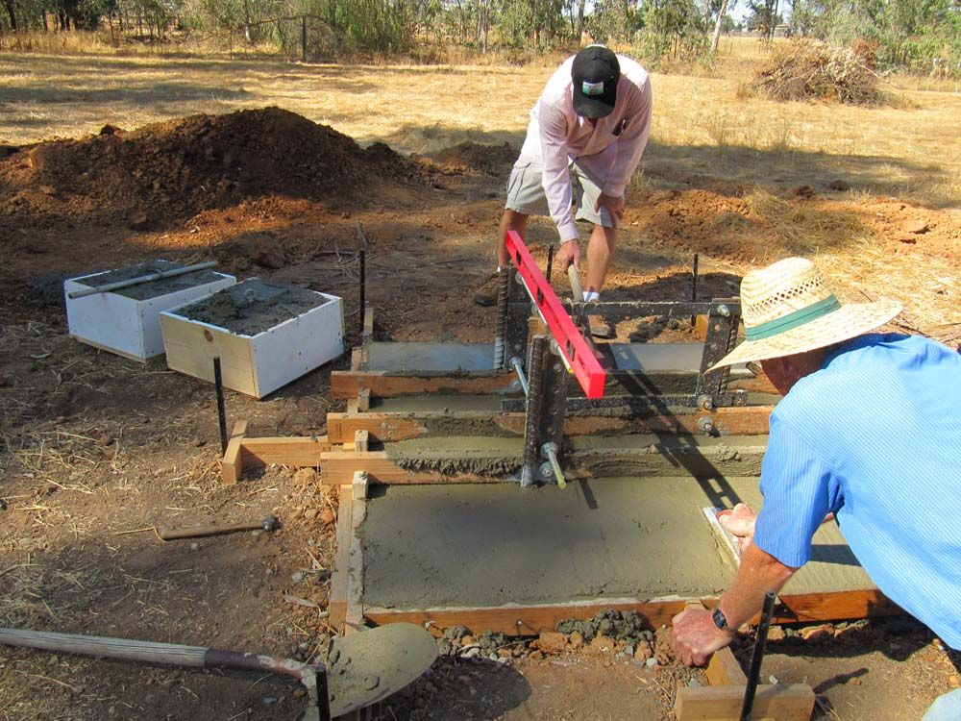
Still level. It never moved but we could have adjusted it if we needed to.

Slide 37
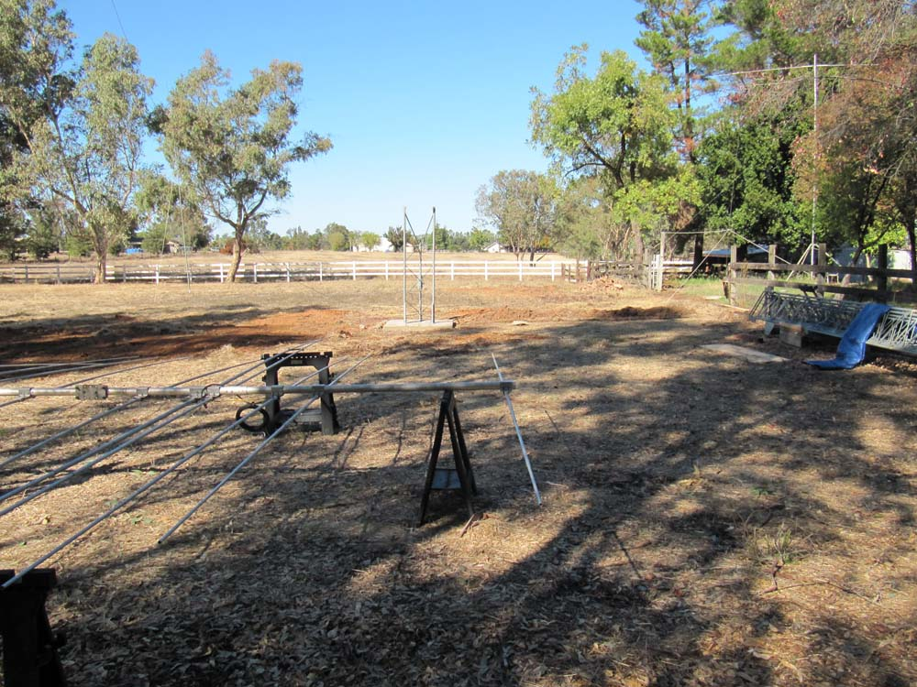
After a week, the forms were removed, the remainder of the steel was galvanized and the tilt frame installed. The XR-5 and other antennas were assembled.

Slide 38
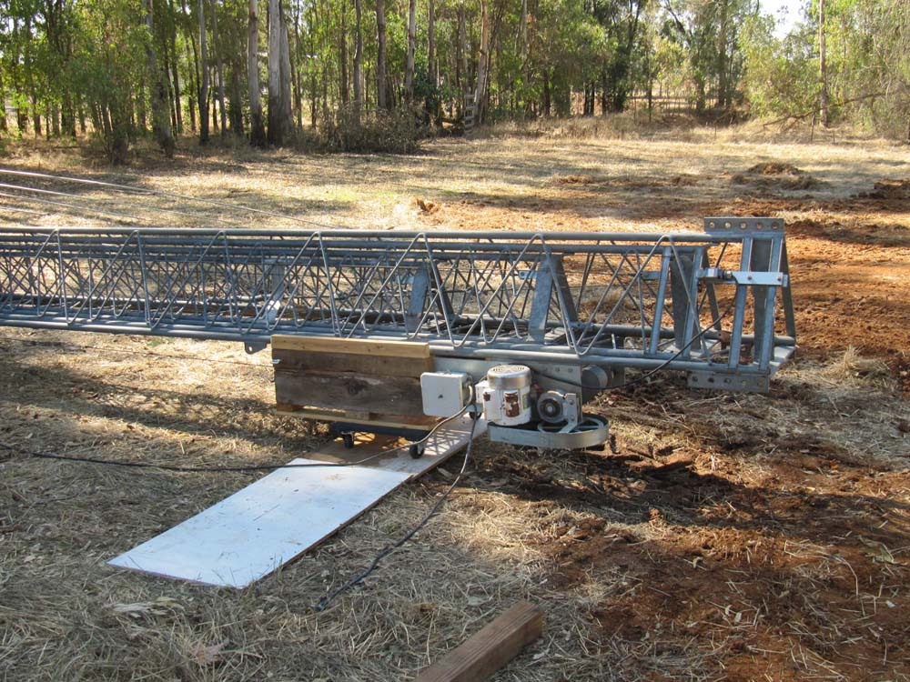
Dollies are placed under the sled and the tower top. Scrap plywood is placed on the ground and the tower pushed towards the base.

Slide 39
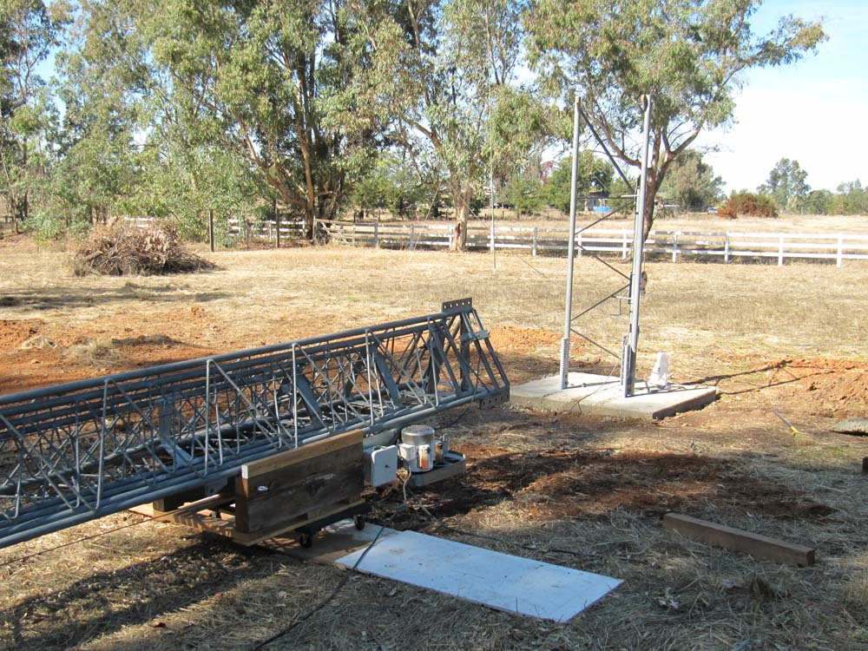
Tower lined up with the base.

Slide 40
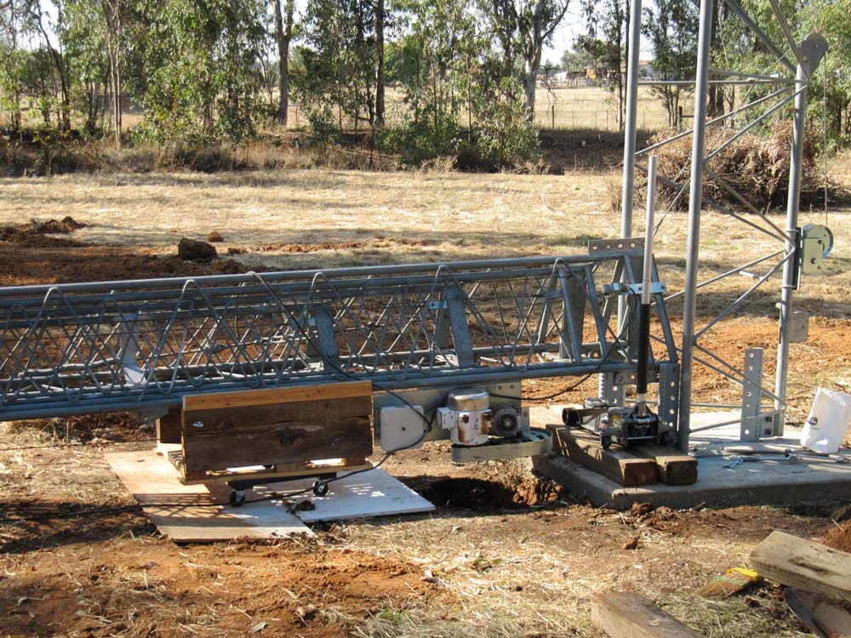
Dolly and sled must be removed, so a floor jack takes and lowers the load. The lifting winch holds the tower in place.

Slide 41
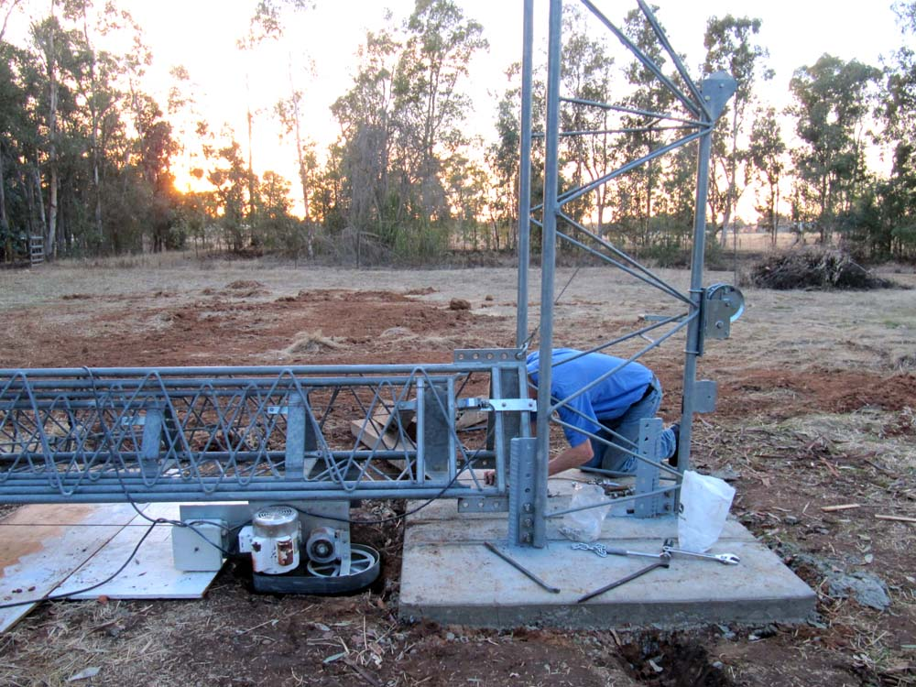
First 2 bolts are in.

Slide 42
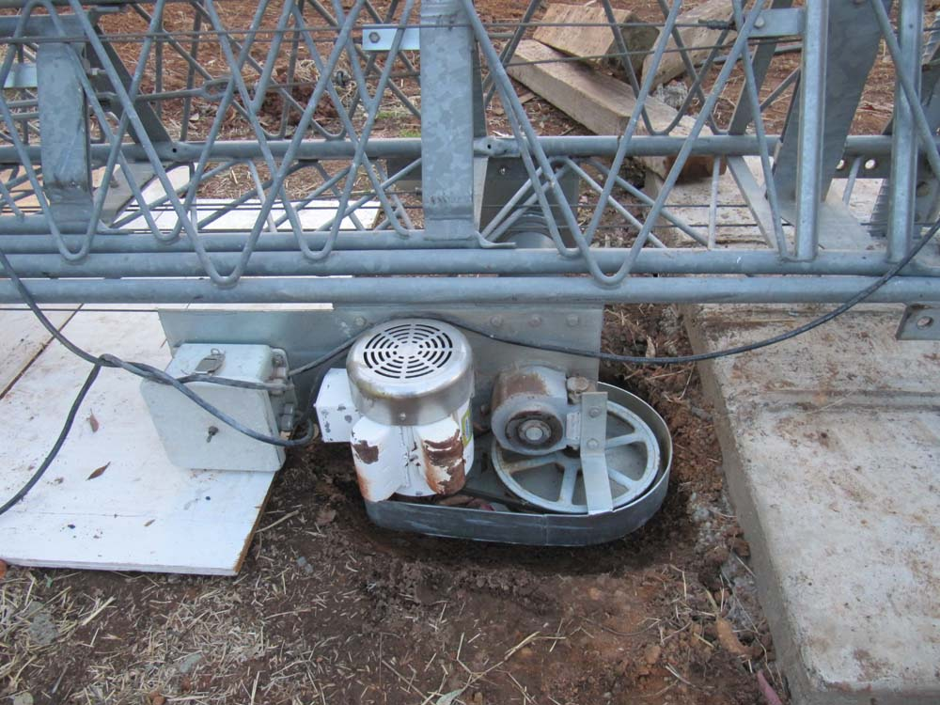
The motor and drum will hit the ground, so a small hole is dug to protect the winch.

Slide 43
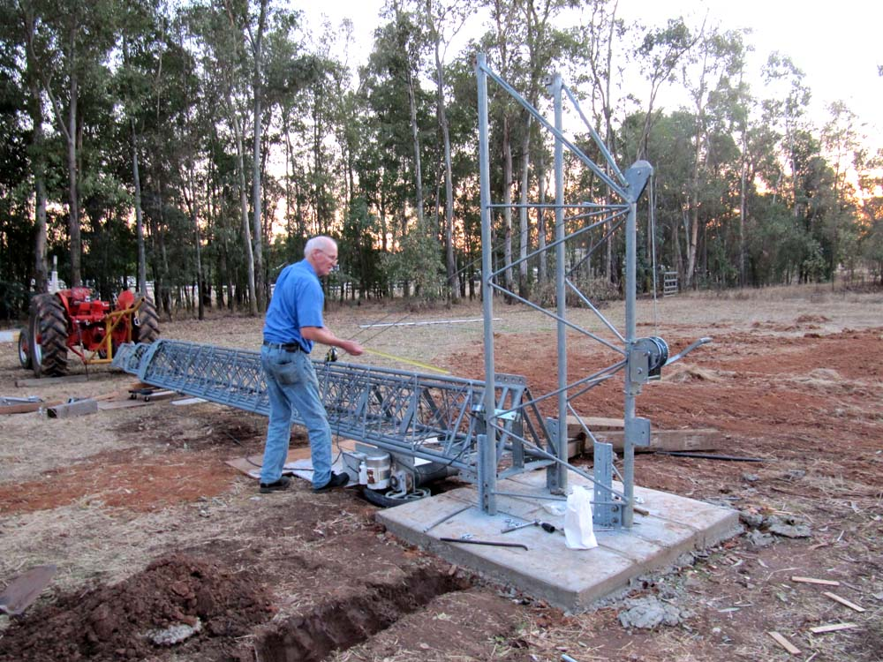
Rigging the pulleys

Slide 44
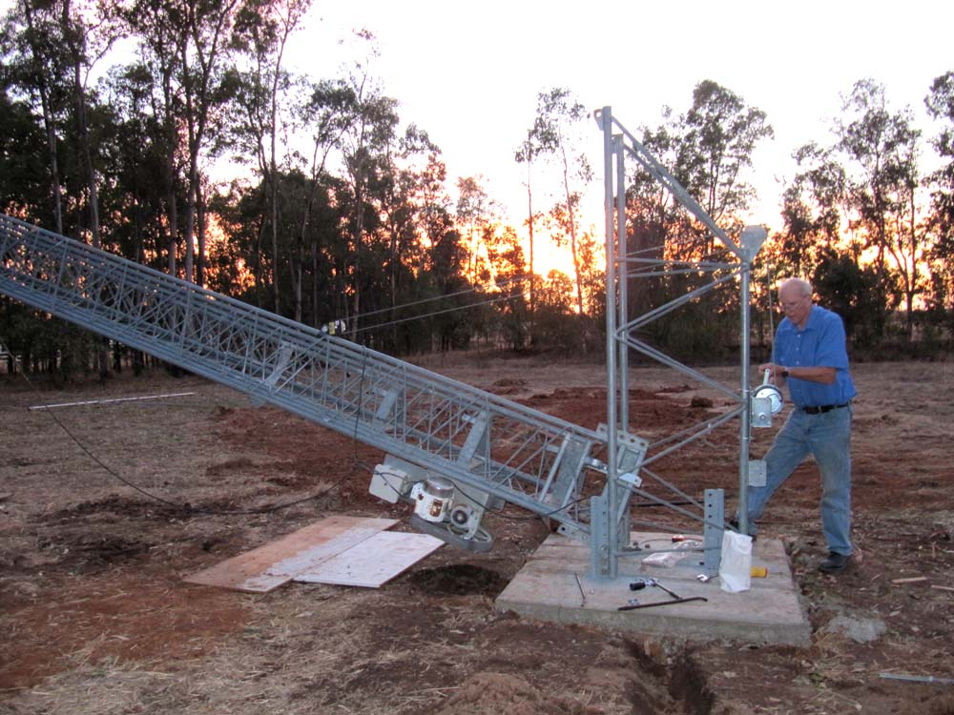
Coming up

Slide 45
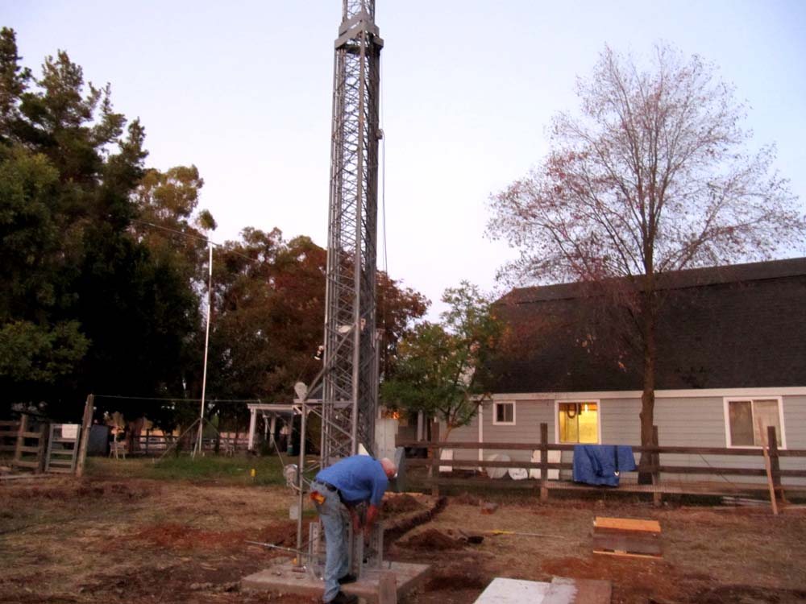
All the bolts were inserted to make sure they all would fit. A large pry bar was needed for the rear holes.

Slide 46
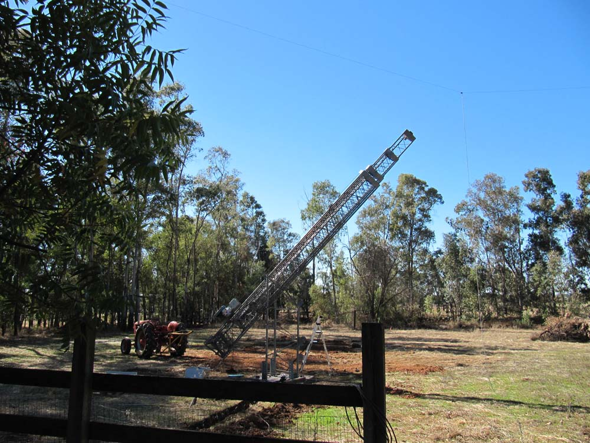
Tilting the tower backward

Slide 47
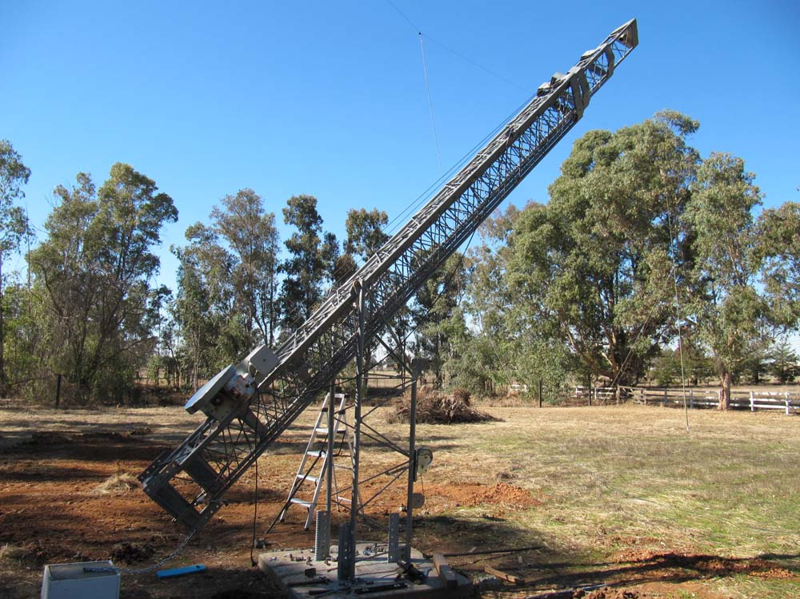
Chain is attached to the counter weight.

Slide 48
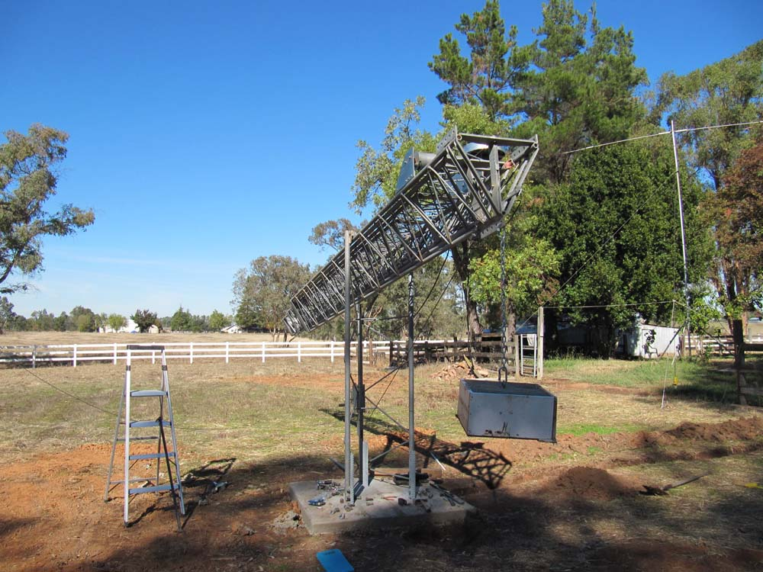
Weight makes the cranking easier.

Slide 49
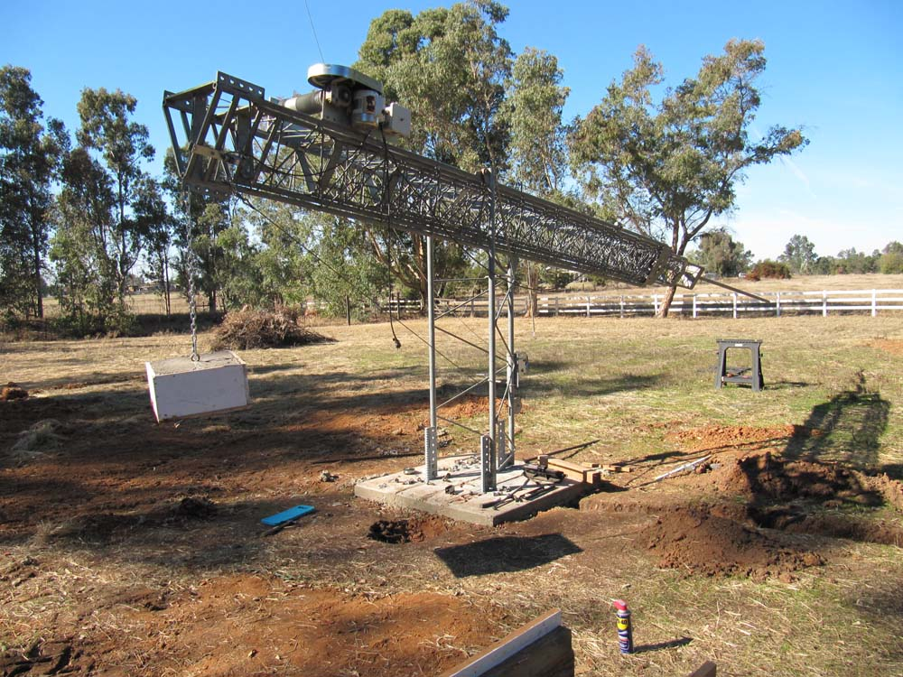
Mast and rotor are added. The cement block weighs about 250 pounds.

Slide 50
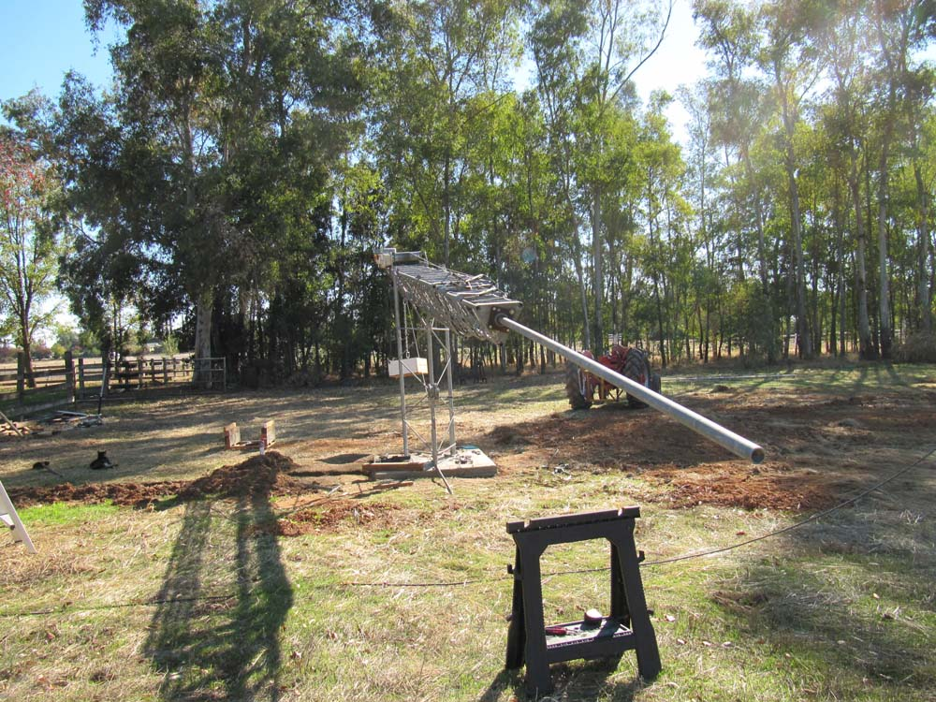
Mast comes close enough to the ground for easy attachment of the upper antennas.

Slide 51
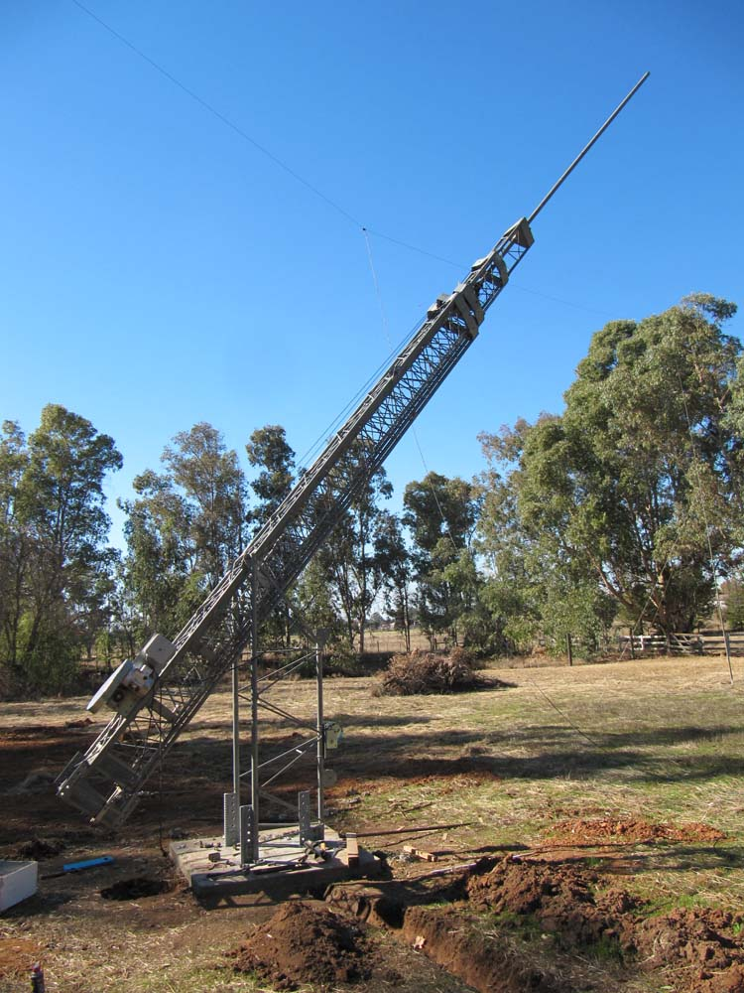
Tower is pulled vertical so the rotor can be centered and tested.

Slide 52

The XR-5 is on the bottom, the 40 meter dipole is in the middle and the 4 element yagi for 6 meters is on the top.

